Slide 1
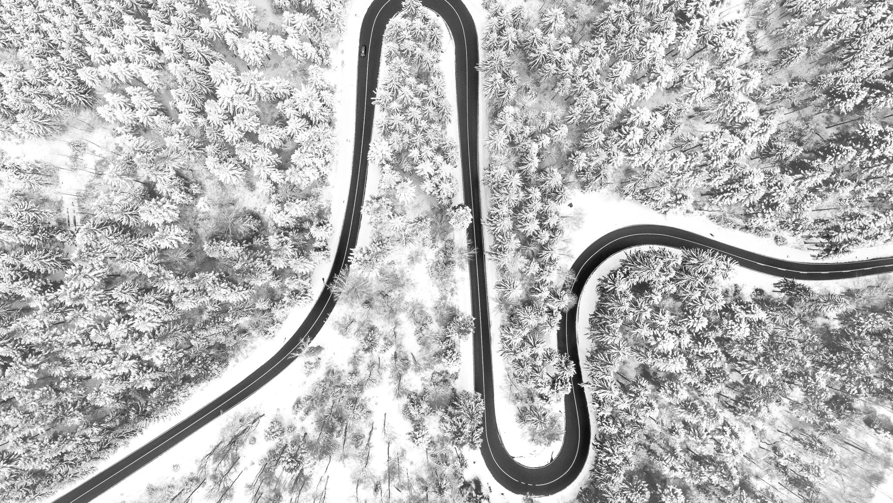
AUTOMATIC ROAD EXTRACTION FROM MULTISPECTRAL HIGH RESOLUTION SATELLITE IMAGES
Rishabh Yadav
22123013

Slide 2
Road Extraction
The significance of road extraction from satellite images originates from the fact that it significantly improves the effectiveness of map production and can therefore be of used in automobile navigation systems or any emergency (rescue) system that requires instant maps.

Slide 3
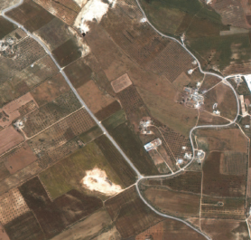
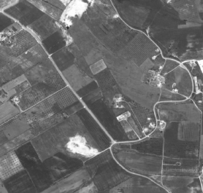
Methodology
Original Image
Convert to grey scale
gray = cv2.cvtColor(satellite_image, cv2.COLOR_BGR2GRAY)
satellite_image = cv2.imread('33.png')

Slide 4

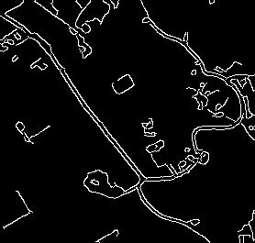
Continued
Gaussian blur Image
Edge detection using canny
gray_blur = cv2.GaussianBlur(gray, (7, 7),0)
edges = cv2.Canny(gray_blur, 50 , 150)

Slide 5

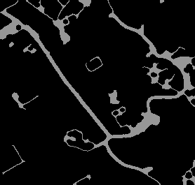
Continued
Thresholding
Morphological closing
thresh = cv2.threshold(edges, 50, 150 ,cv2.THRESH_BINARY)
kernel = cv2.getStructuringElement(cv2.MORPH_ELLIPSE, (7, 7))
closed = cv2.morphologyEx(thresh, cv2.MORPH_CLOSE, kernel)

Slide 6
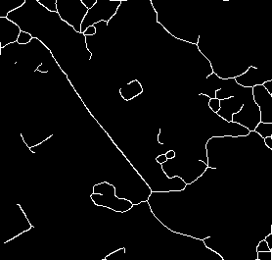
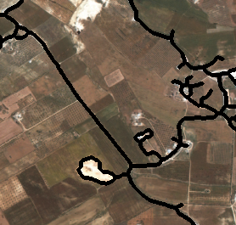
Continued
Thinning
Contour making
thinned = cv2.ximgproc.thinning(closed)
Contour making involves three steps
Contour detection
Contour filtering
Draw contours.

Slide 7
Some other results generated through this process

Slide 8
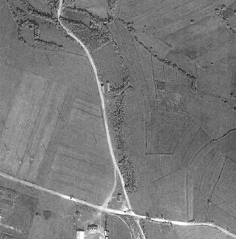
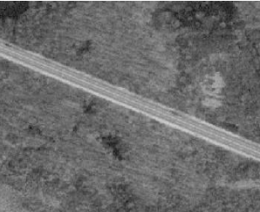
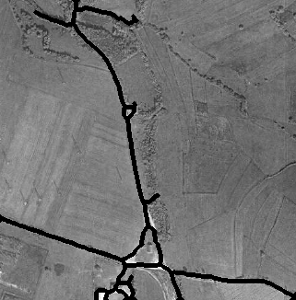
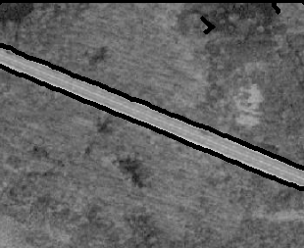
Input Satellite Image
Output Road Extraction

Slide 9
References
Automated Road Extraction From High Resolution Satellite Images Jose Hormese , Dr. C. Saravanan.
AUTOMATIC ROAD EXTRACTION FROM MULTISPECTRAL HIGH RESOLUTION SATELLITE IMAGES Uwe Bacher and Helmut Mayer.
Automatic Road Extraction from Aerial Image John C. Trinder, Yandong Wang.
https://bhuvan-app1.nrsc.gov.in/globe/2d.php# “For downloading the image data.”
https://earthexplorer.usgs.gov/ “For downloading the image data.”

